Slide 1
ERTS Final Assessment – Task 2 (Template)
Kalyan Sudra – eo20203
Ronaldo Balram – nz20469
Khush Shah – bi20475
Qijia Tang – dm22509

Slide 2
Practical elements
Show that the LED has been used effectively
Show that the robot can move around effectively
Show that the robot can play a tune
Show that all of this works simultaneously

Slide 3
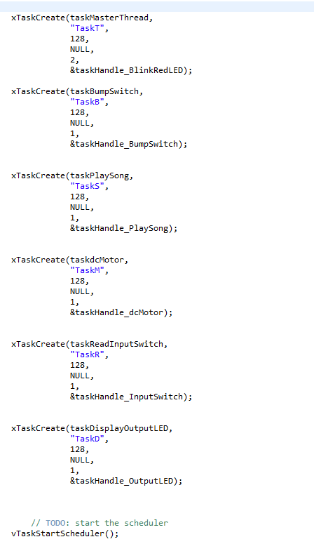
Tasks/Scheduling
We created various tasks with “taskMasterThread” having the highest priority and utilised the round robin scheduling algorithm.
With round robin at a high frequency all tasks seem to be running concurrently on a single processor.
Tasks are easily able to be suspended and resumed re-joining the schedule.
Deals with all processes without any priority

Slide 4
Resource control
How have you controlled access to any shared data/hardware?
We have controlled access to shared data using the various tasks and the paths you take.
- bumpSwitch_status is a global variable and is being shared in the various tasks so that they are aware of the status.

Slide 5
Suspend and Delete
What is the difference between suspend and delete task and what are their uses ?
Tasks that are deleted are removed from “all ready, blocked, suspended and event lists”. No longer able to be used. Useful to delete a task and free memory.
Suspended tasks are unable to execute unless explicitly told to meaning it can stop and resume to join the round robin schedule again

